Slide 1
Meeting 7
Tuesday 13/02/2018

Slide 2
Agenda
Park model
Test case
CT curve
BEACon data
LES results
WAsP & Fuga
Next steps

Slide 3
Park model
Implemented methods
Park 1 or Park 2: correction term
Area Averaging: A_overlap/A_rotor for any point in space
Superposition method: linear, maximum deficit or quadratic
Wake reflection
Section in 3 directions
Horizontal at chosen height
Vertical at downstream position
Vertical at cross-stream position

Slide 4
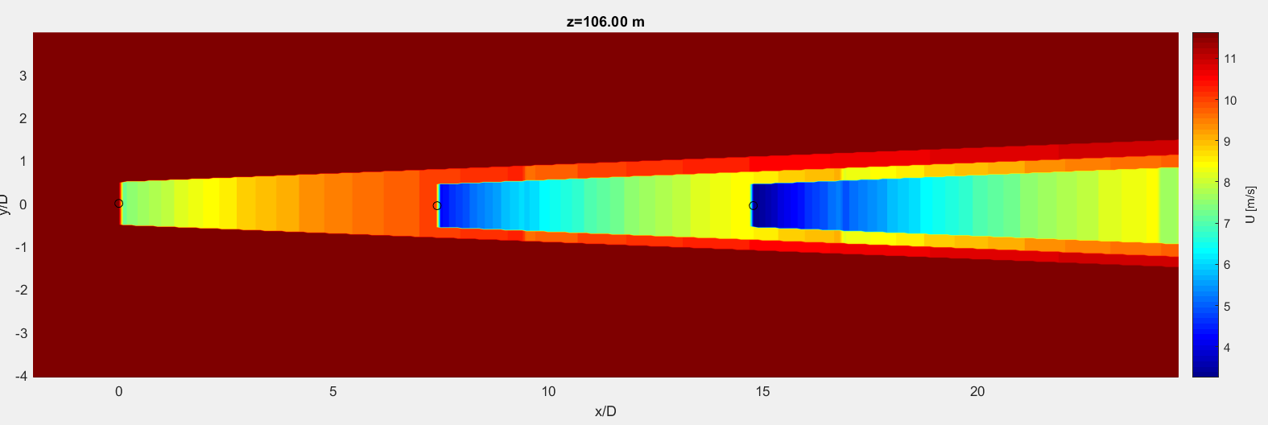
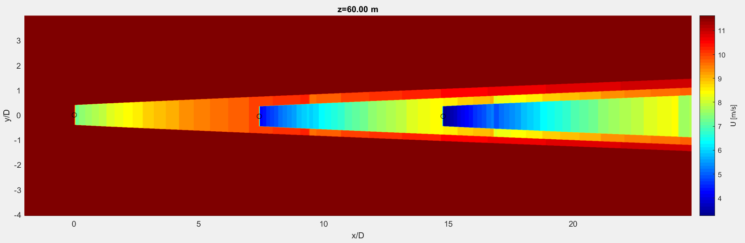
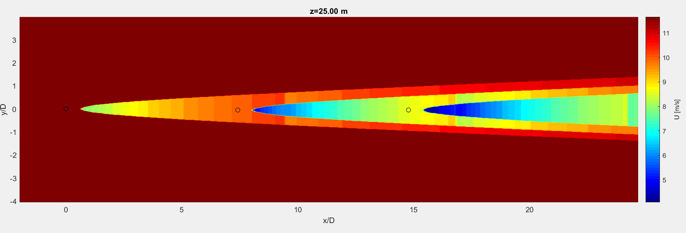
Park model: horizontal section
Notes:
Park 1
Quadratic
K=0,04
With wake reflection

Slide 5
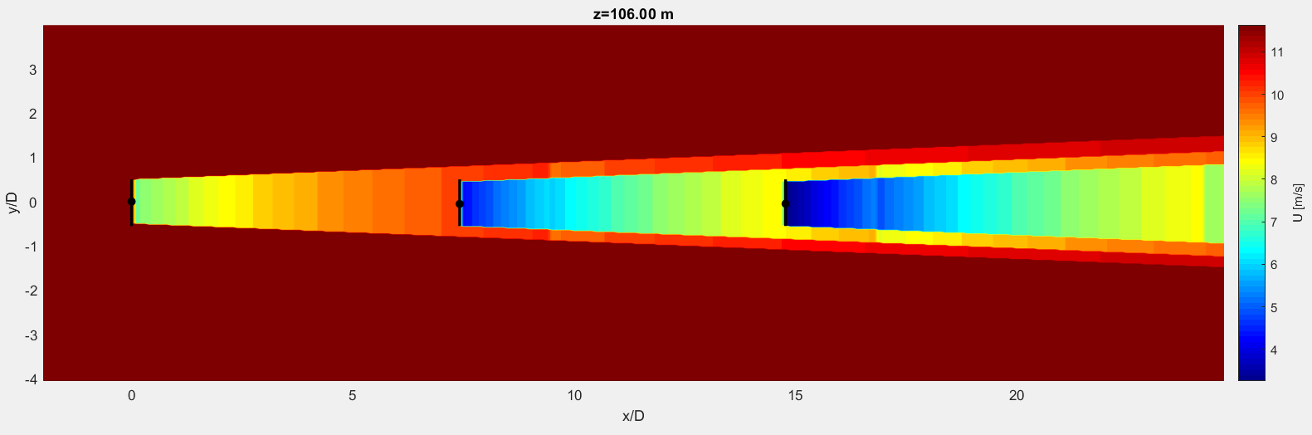
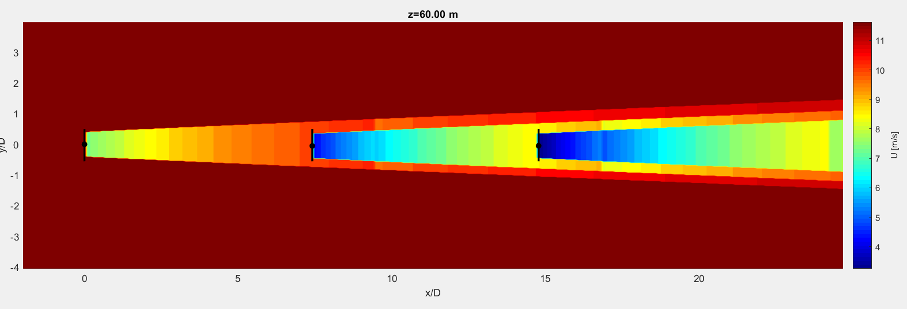
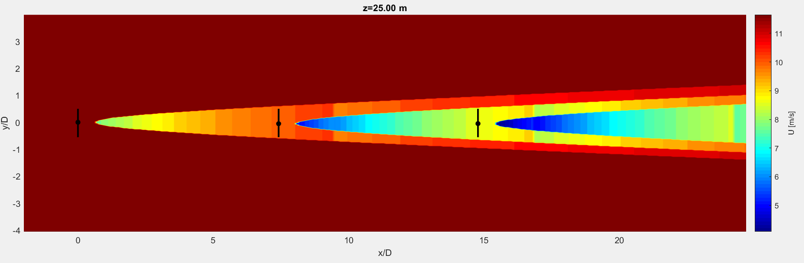
Park model: horizontal section

Slide 6
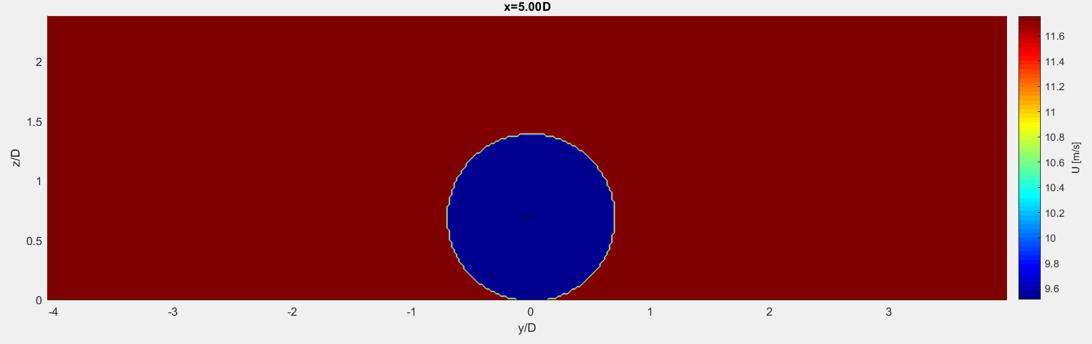
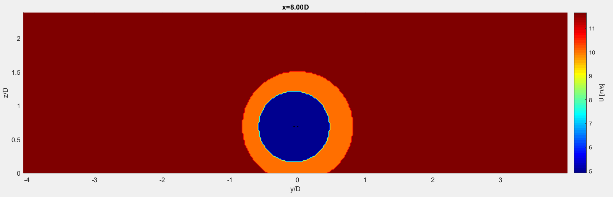
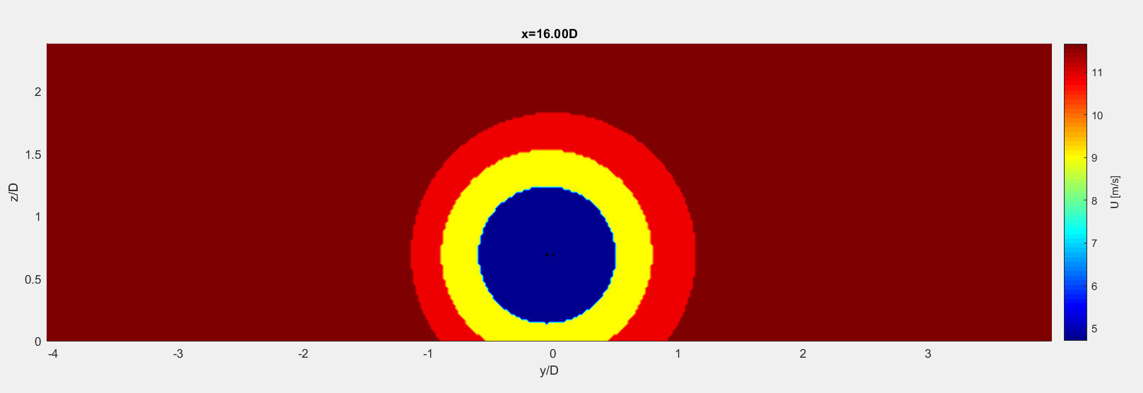

Slide 7
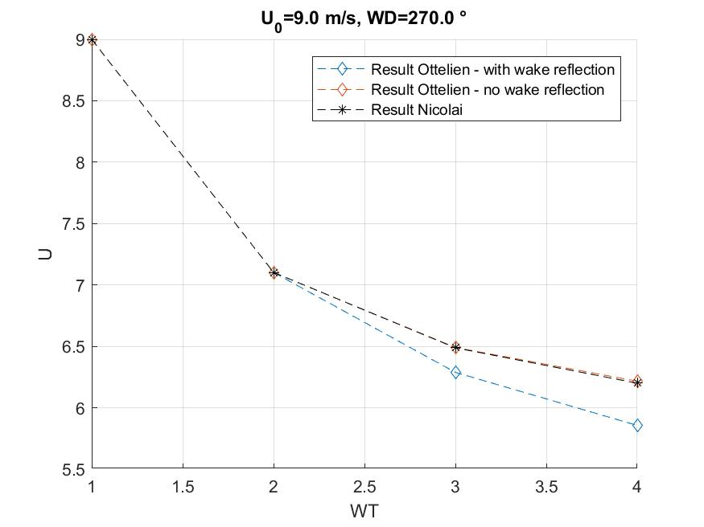
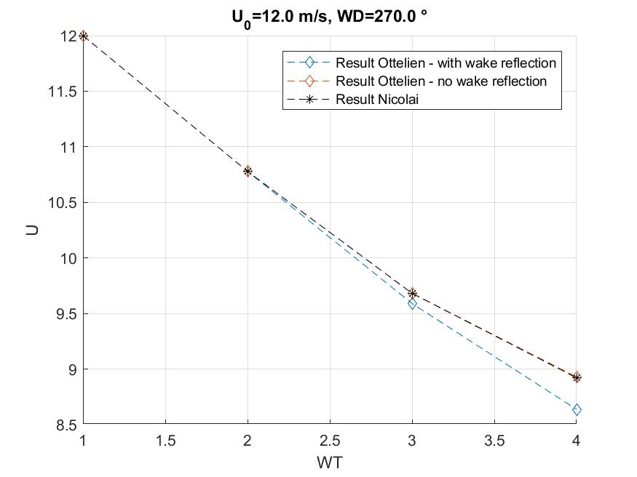
Test case

Slide 8
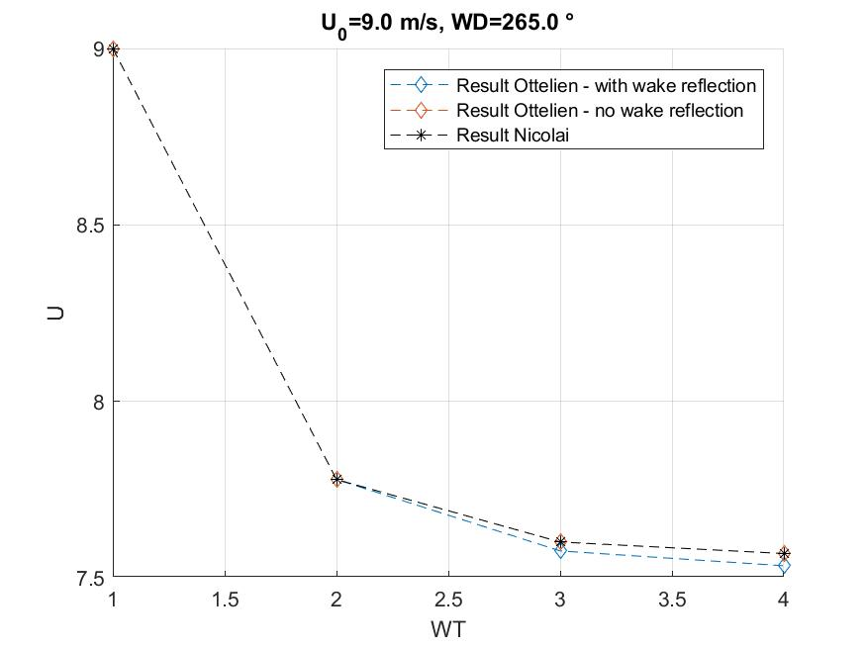
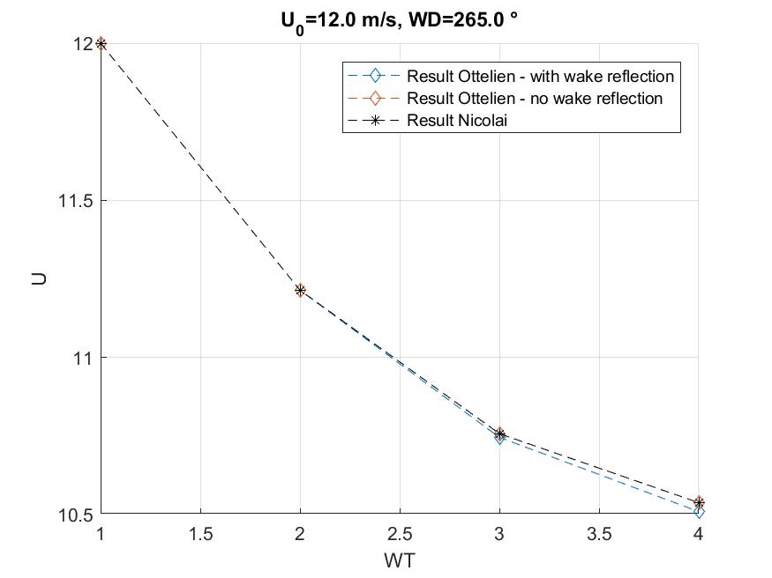
Test Case

Slide 9
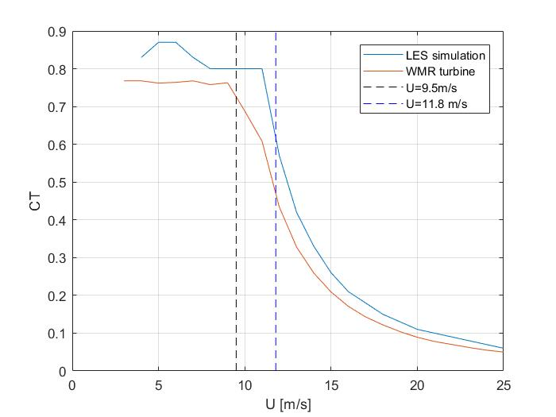
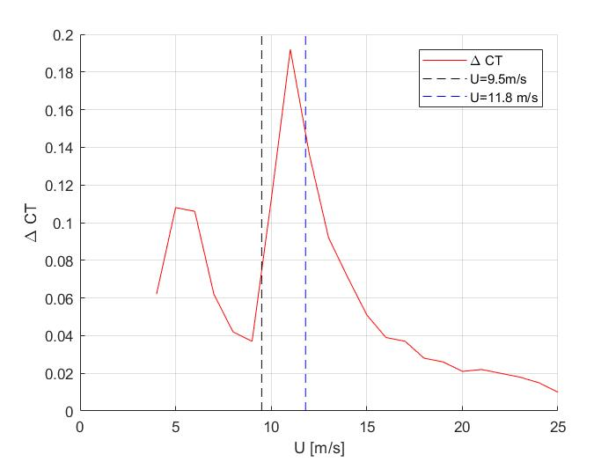
CT curve

Slide 10
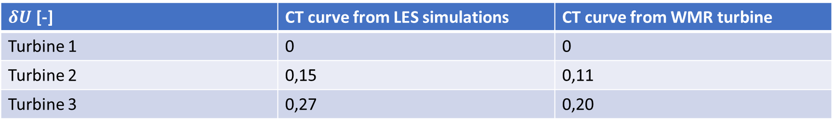
U/U0 | CT curve from LES simulations | CT curve from WMR turbine
Turbine 1 | 1 | 1
Turbine 2 | 0,85 | 0,89
Turbine 3 | 0,73 | 0,80
$U/U_{0}$ [-] | CT curve from LES simulations | CT curve from WMR turbine
$δU$ [-] | CT curve from LES simulations | CT curve from WMR turbine
Turbine 1 | 0 | 0
Turbine 2 | 0,15 | 0,11
Turbine 3 | 0,27 | 0,20

Slide 11
BEACon data
10-min average
How are the data interpolated?
Data is given in Cartesian X,Y,Z frame
Measurements are in tilted plane

Slide 12
LES results

Slide 13
WAsP & Fuga
No met. data available Used data from another project, does not change Fuga results
WT file:
CT curve of LES data

Slide 14
Next steps

